Slide 1
DOORI
The Social Distancing Tracker
Final Review

Slide 2
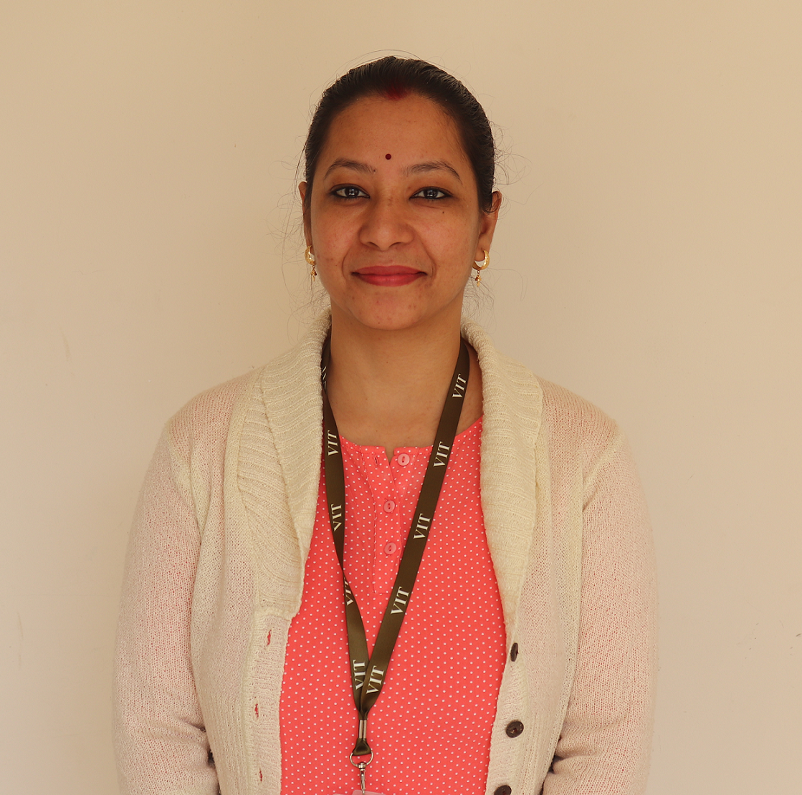
Project Guide
Dr. Abha Trivedi
Assistant Professor

Slide 3
Team Members
Shikhar Vashishtha – 19BCE10025
Vardaan Vishnu – 19BCE10063
Prantik Bhattacharjee – 19BCE10222
Prashant Chauhan – 19BCE10280

Slide 4
Objective & Problem Statement
In the current Covid-19 situation, safety measures taken by the governments around the world have failed in front of Covid-19, due to lack of social distancing practice.
Newer variants of the virus have emerged that are equivalent or more dangerous than the previous one. Thus, it becomes a monumental challenge to tackle the issue of social distancing in an overly populated country like India.
Doori aims to combine Computer Vision to create a real-time social distance monitoring software so that administrators can use them to locate breach of bio-bubbles. It uses OpenCV library and YOLO v3 for real-time human detection.

Slide 5
Existing work with limitations
Social distancing trackers are useful in ensuring proper W.H.O. guidelines on COVID-19.
But software lack the integration of a mask detector in them.
Both of these features are not integrated in a single package, since they have different requirements and physical limitations.

Slide 6
Proposed work
Doori aims to combine Computer Vision to create a real-time social distance monitoring software.
It would be able to scan for environments in real-time for breach of bio-bubbles. The parameters will be flexible, so that the administrators can use them at their own behest.
It utilizes OpenCV library and YOLO v3(You only look once) for real-time object detection to detect humans.

Slide 7
Real Time Usage
Various daily life tasks have been automated with the help of computer vision (branch of AI). How our app can be used in real time scenario:
The algorithm can be used to analyze social distancing in a public area and carry out necessary actions to better deal with the pandemic.
Automating the task will lead to effective actions taken in a short time hence equipping us better to deal with the situation.

Slide 8
Future Improvements
Real-Time alert: We send an alert in real-time. If the total number of violations (say 10 or 30) exceeded in a store/building, we simply alert the staff. We can set the max. violations limit (Threshold = 15). This is pretty useful considering the COVID-19 scenario.
Threading: If you ever see a lag/delay in your real-time stream, consider using Multi Threading. It removes OpenCV's internal buffer (which basically stores the new frames yet to be processed until your system processes the old frames) and thus reduces the lag/increases fps. It is most suitable for solid performance on complex real-time applications.
ML: Train our model using Machine Learning for better accuracy.

Slide 9
Hardware & software requirements
The Software requirements are:
Python 3.5.2
Opencv(CV2) 4.2.0
Numpy 1.14.5
For human detection: YOLOv3.weights, YOLOv3.cfg files
For running: Good GPU, for faster results. We have tried it on CPU.
Hardware requirements include:
Camera
24x7 running System for seamless tracking and to run python script

Slide 10
System Architecture
Project Management Infographics
YOLOv3
Regression
Predicts bounding
boxes using dimension clusters as anchor boxes.
Regression
Treated as logistic regression problem than a multilabel classification problem.
YOLOv3
Centroid
Accuracy
Centroid
Less accurate but faster.
Accuracy
Return the person prediction probability.

Slide 11
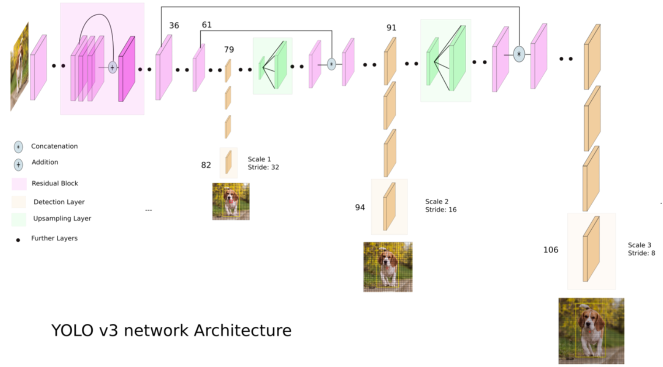

Slide 12
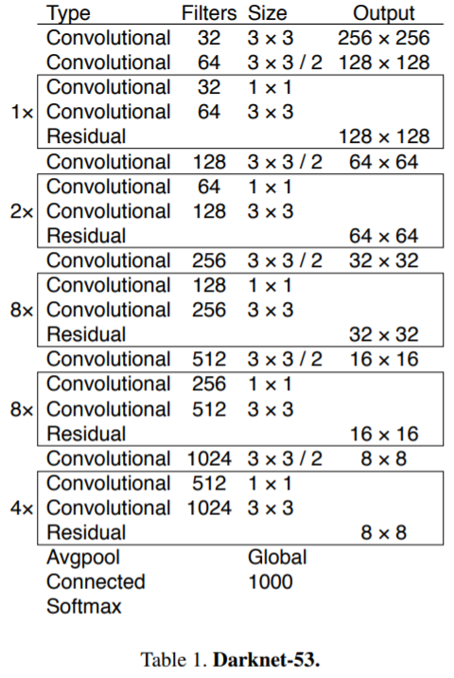

Slide 13
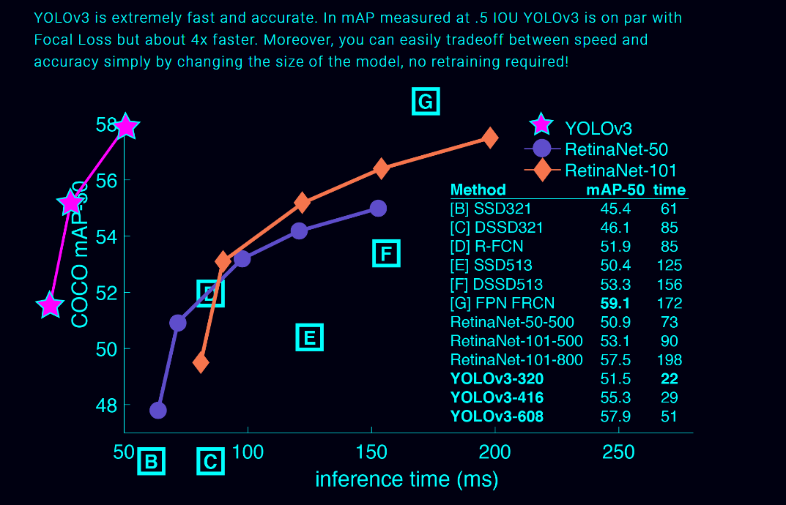
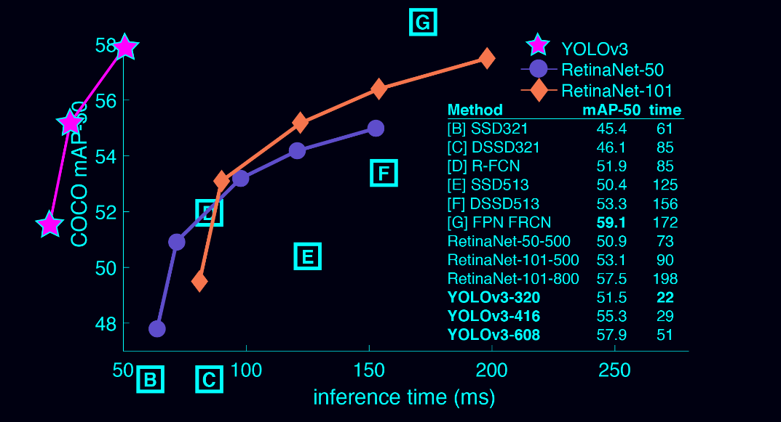

Slide 14
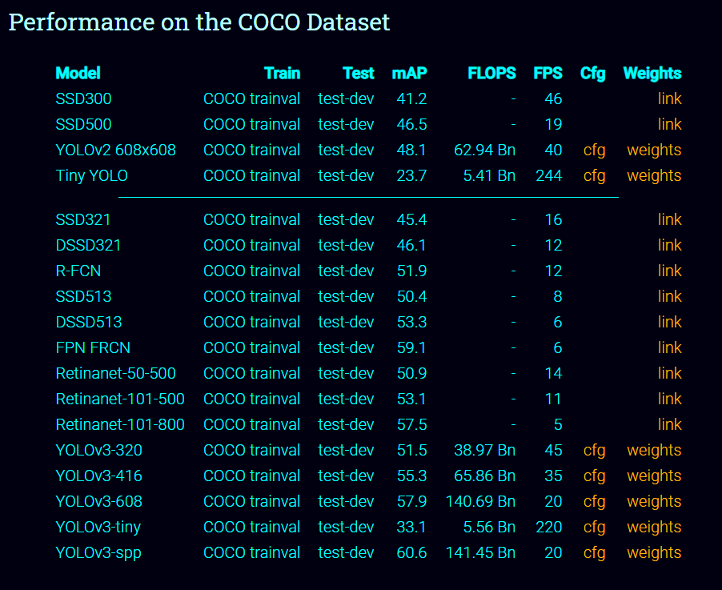
Performance

Slide 15
Camera Perspective Transformation
Input video may be taken from any arbitrary perspective, the first step is to transform perspective of view to a bird’s-eye (top-down) view.
As the input frames are monocular (taken from a single camera),we select the perspective view which defines ROI where we want to monitor social distancing.
The next step to detect pedestrians and draw a bounding box around each pedestrian.
Last step is to compute the bird’s eye view distance between every pair of people.

Slide 16
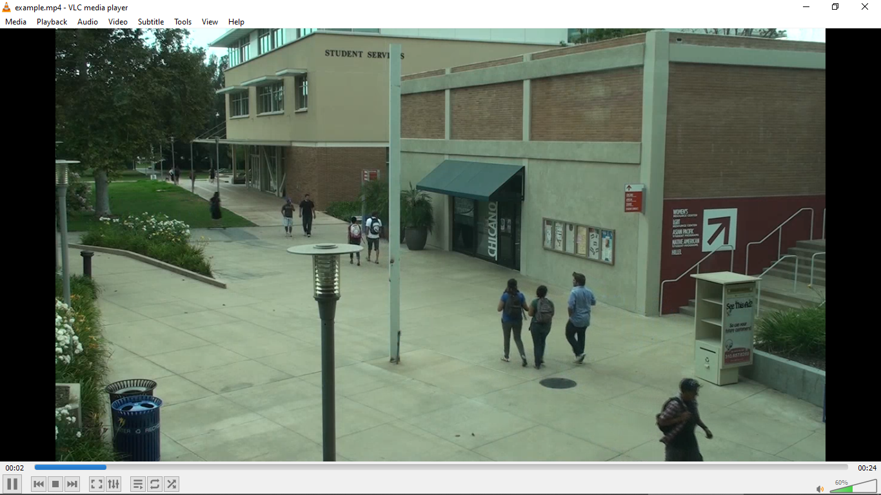
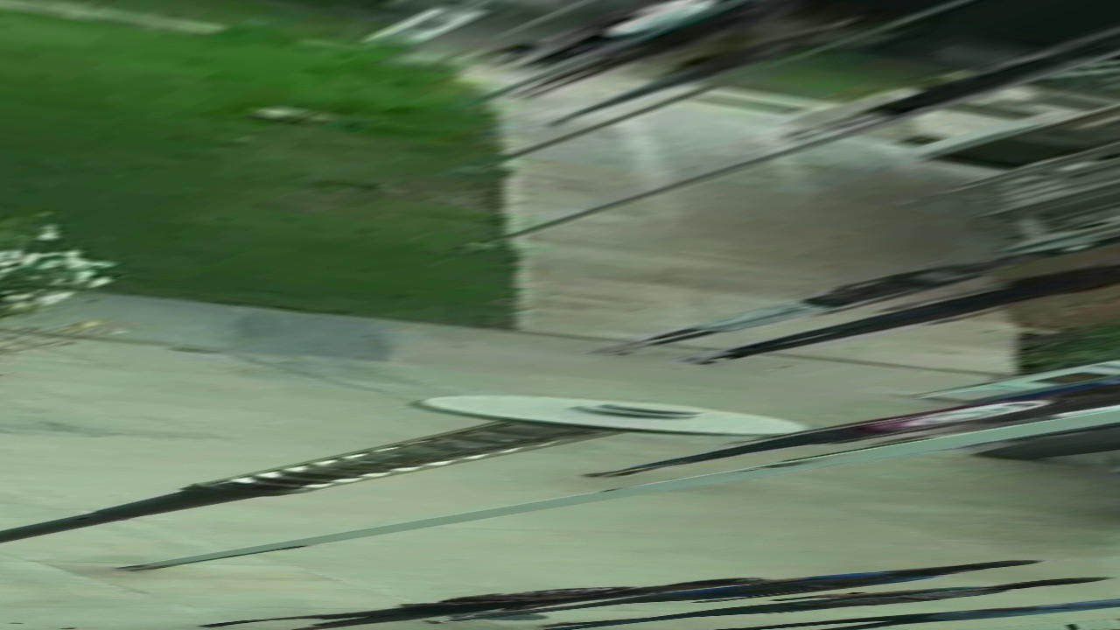
The Camera Perspective Transformation results in a Bird’s Eye View of the ROI.

Slide 17
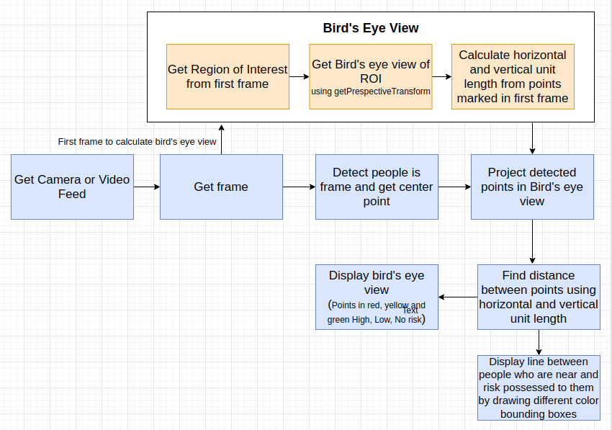
Code Flow

Slide 18
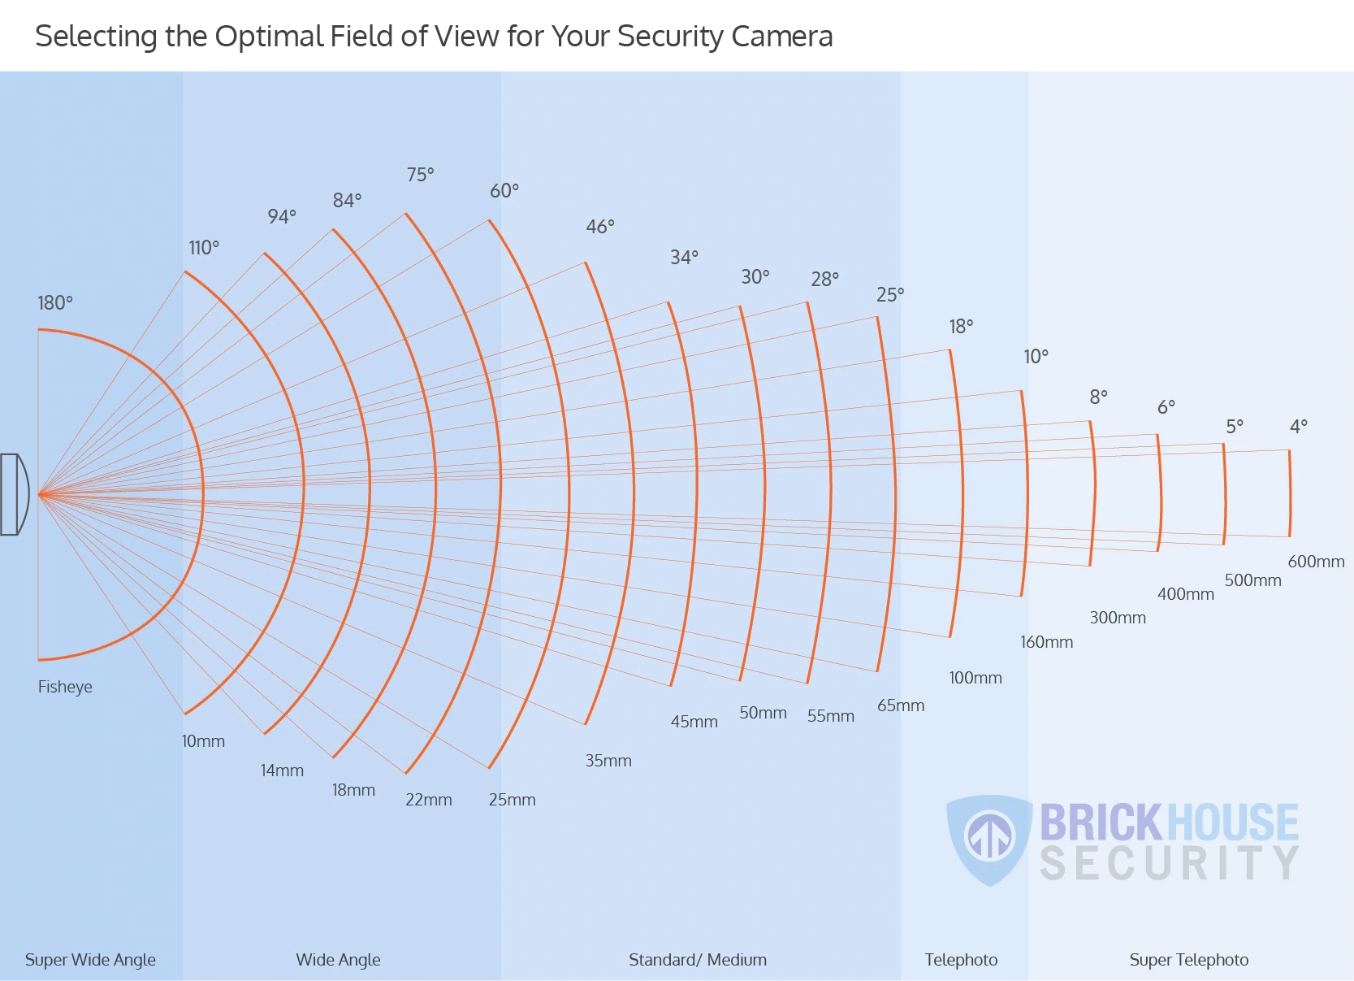

Slide 19
Camera Calibration
A wide-angle lens camera captures more objects but fewer details.
A standard/medium camera is best to capture something specific or highly detailed. If you need to capture fewer objects but in a greater detail, a narrow-angle camera lens is a better choice.
Thus, wide-angle camera are not suitable for object detection.
Lenses covering a viewing angle of 60 to 25 degrees are considered best in this scenario.

Slide 20
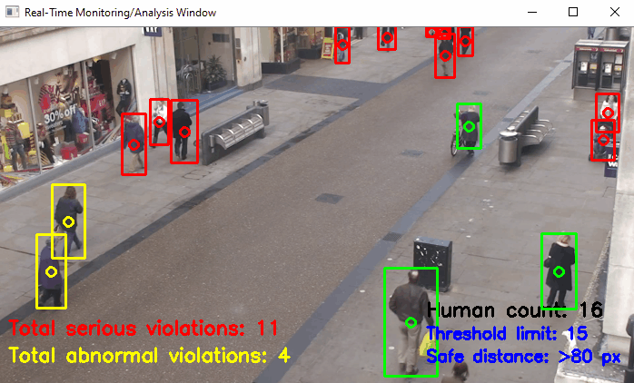
Demo

Slide 21
Thank You!

